Slide 1



Work-Life Balance in HR
A Strategic Analysis at Crimsun Organics Pvt. Ltd.
Project by G. Selsiya
Final year MBA student, C.K. College of Engineering & Technology
Under the Supervision of Dr. K. Prakash
Department of MBA, CKCET, Cuddalore
Presented to Anna University
In partial fulfillment of MBA degree requirements
Notes:
Welcome to my final year MBA project presentation, focusing on the vital issue of work-life balance within the HR function. This project was conducted at Crimsun Organics Pvt. Ltd. in Cuddalore, a company known for its industrial rigor and growing corporate culture.
Guided by Dr. K. Prakash, this study aims to explore not only the employee experiences and company policies but also benchmark Crimsun’s practices against global standards. We’ll journey through data-driven insights, practical challenges, and strategic recommendations that could redefine HR in manufacturing environments.
Let’s begin with a deeper look at why work-life balance is a cornerstone for modern HR success—and how it can be a game changer for organizations like Crimsun Organics.

Slide 2



Agenda
Overview of the Presentation Structure
Introduction to Work-Life Balance
Exploring the relevance and HR significance of WLB in modern organizations
Case Study: Crimsun Organics Pvt. Ltd
Examining current practices and employee experiences at the company
Findings and Recommendations
Insights from the field study and strategic proposals to enhance WLB
Notes:
This presentation is structured into three core segments. First, we'll establish a comprehensive understanding of what work-life balance entails and why it's crucial in HR, particularly in demanding industries.
Next, we’ll dive into a detailed case study of Crimsun Organics, presenting real employee feedback, organizational data, and the current support systems in place. This provides us a grounded, real-world context to evaluate effectiveness.
Finally, based on extensive analysis, I’ll present key findings and evidence-based recommendations aimed at improving employee satisfaction and organizational productivity through targeted work-life balance interventions.

Slide 3

Introduction to Work-Life Balance
Balancing Professional and Personal Responsibilities
Definition of Work-Life Balance: A state where individuals effectively manage time between work duties and personal life
Importance in HR Context: Improves employee well-being, productivity, and retention; reduces stress and absenteeism
Growing Global Relevance: Changing workforce expectations post-COVID emphasize flexibility, empathy, and mental health
Notes:
Work-life balance is the ability to equally prioritize professional responsibilities and personal life. It is no longer just a desirable perk but a strategic necessity in HR, especially post-pandemic.
In HR terms, work-life balance directly influences employee engagement, absenteeism, and turnover. A well-structured balance helps in creating a healthier, more satisfied workforce.
With evolving work norms and the rise of hybrid work, employees now expect empathy, autonomy, and mental health support from their employers. Recognizing and addressing these expectations is fundamental for organizations aiming to be competitive and sustainable.

Slide 4


Crimsun Organics Pvt. Ltd.
Company Overview & Background
Founded in 2016
Specializes in manufacturing crop protection chemicals at Cuddalore, Tamil Nadu
Facilities & Production
Multipurpose plant with 1,425 T/month capacity and advanced treatment systems
Global Operations
Exports to EU, USA, Brazil; registration underway in Canada, Colombia, and India
Notes:
Crimsun Organics Private Limited is an emerging leader in the Indian agrochemical industry, established in 2016. The company focuses on the manufacturing of active ingredients and intermediates for crop protection products.
Their facility in Cuddalore, Tamil Nadu is state-of-the-art, equipped with stainless steel and glass-lined reactors and capable of treating effluents with zero liquid discharge systems. The company maintains rigorous environmental and safety standards.
With international certifications and active export channels to the EU, USA, and Brazil, Crimsun is expanding its footprint. Their focus on sustainability, quality, and innovation positions them as a key player in the global agricultural chemical sector.

Slide 5
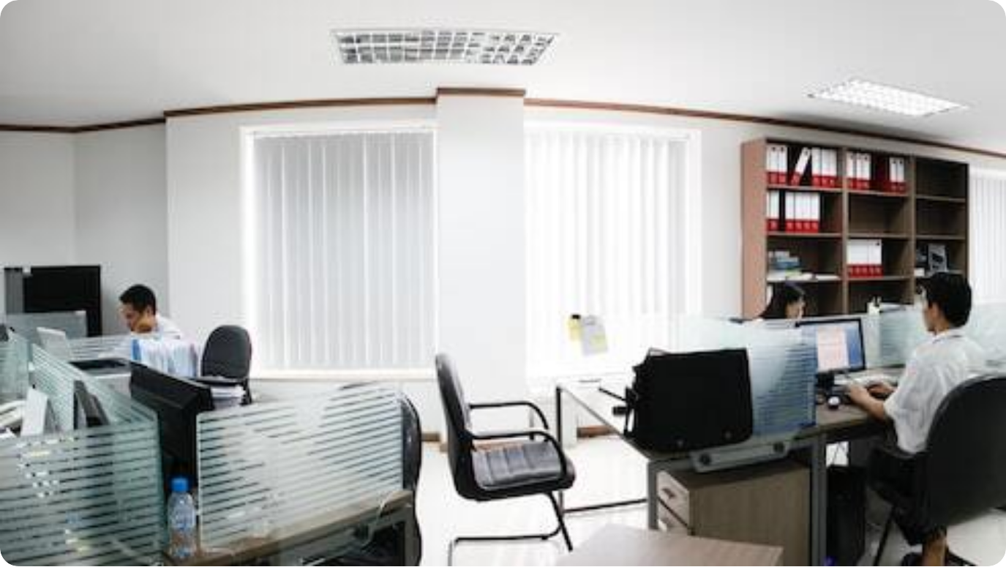
Current WLB Practices at Crimsun
How Crimsun Organics Supports Work-Life Balance
Fixed Working Hours: 65% of employees report having consistent daily schedules
Leave & Emergency Policies: 56% agree there’s adequate freedom to take emergency leaves
Managerial Support: 34% rate managerial encouragement for WLB as very good
Notes:
At Crimsun Organics, certain foundational elements of work-life balance are already in place. The majority of employees benefit from fixed working hours, ensuring predictability and routine.
In terms of leave policies, over half of the workforce feels confident in taking emergency leaves without administrative barriers. This signals a certain level of empathy embedded within HR operations.
Managerial support also plays a significant role. A noteworthy 34% of respondents find their managers proactive in fostering work-life balance. While these numbers show promise, there is room for development, particularly in aligning broader organizational policies with global WLB benchmarks.

Slide 6

Employee Perspectives – Positives
Perceived Strengths of Work-Life Balance at Crimsun
Supportive Supervisors: Employees cite strong interpersonal support from direct managers
Leave Policy Satisfaction: 33% rated leave policies as very good, 30% as good
Workplace Stability: Over 50% of employees are willing to stay based on WLB experience
Notes:
From the employee perspective, several aspects of Crimsun’s work-life balance framework stand out positively. Many employees acknowledge their supervisors as empathetic and supportive, which is vital for maintaining morale in a manufacturing context.
The leave policy is well-received: 63% of respondents rate it good or very good, reflecting satisfaction with the accessibility and fairness of current leave provisions.
Importantly, more than half of the respondents indicated a willingness to continue their tenure at Crimsun due to work-life balance satisfaction. This signals a foundational success upon which the company can build further improvements.

Slide 7



Employee Challenges & Concerns
Barriers to Effective Work-Life Balance at Crimsun
Commute Fatigue
41% report commute times negatively affect work-life balance
Inadequate Remote Options
74% state there is no opportunity for hybrid or remote work
Weekend Work Conflicts
46% agree that weekend work disrupts personal plans
Notes:
Despite positive feedback on some fronts, there are key challenges impacting employee work-life balance at Crimsun Organics. One major concern is the commute—over 40% of respondents report that long travel times lead to fatigue and conflict with family responsibilities.
A notable gap is the absence of remote or hybrid work opportunities. Nearly three-fourths of employees said they have no option to work from home, limiting flexibility and increasing stress during high-demand periods.
Additionally, weekend duties remain a problem, with 46% of employees acknowledging interference with personal time. These pain points present strategic improvement opportunities to enhance Crimsun’s HR policies and employee satisfaction.

Slide 8



HR Policies Supporting Work-Life Balance
Key Initiatives and Policy Framework at Crimsun
Structured Leave Systems
Includes emergency leave access and planned paid leaves
Fixed Working Hours
65% of employees benefit from predictable daily schedules
Encouraging Managerial Culture
Managers rated highly for being WLB-supportive by 34% of employees
Notes:
Crimsun Organics has several HR policies in place that support work-life balance to varying extents. First among these is a structured leave system that accommodates both planned and emergency needs. Over half of the workforce finds this setup effective and accessible.
The organization also offers fixed working hours, which the majority of employees appreciate. This regularity helps maintain work boundaries and personal routines.
Most importantly, there is a growing culture among management to support work-life balance. A third of employees find their managers actively enabling such balance. These HR efforts form the backbone for future improvements and strategic WLB advancements.

Slide 9

Global Best Practices for WLB
Strategies from Leading Organizations Worldwide
Flexible Work Arrangements: Tech giants like Google and Microsoft allow hybrid models with personalized hours
Employee Assistance Programs: Mental health support, counselling, and wellness budgets by firms like Deloitte
“No Email After Hours” Policies: Adopted by Volkswagen and Daimler to avoid burnout and overwork
Notes:
Across the globe, leading companies have adopted innovative work-life balance strategies that go beyond traditional HR norms. Google, Microsoft, and other tech leaders have institutionalized flexible work models that allow employees to choose work hours and remote work setups.
Deloitte and PwC offer structured Employee Assistance Programs (EAPs), providing access to counselling, fitness subsidies, and mental health awareness campaigns.
In a bold cultural move, companies like Volkswagen and Daimler enforce digital downtime policies—no emails or calls after work hours—to combat burnout. These policies reflect a growing realization that employee well-being is central to organizational performance and reputation.

Slide 10



Impact on Retention & Productivity
Why Work-Life Balance Is a Business Imperative
Lower Turnover
WLB-friendly companies report up to 50% reduction in attrition (HBR, 2023)
Enhanced Productivity
Microsoft’s 4-day week trial showed a 40% increase in output (Japan, 2021)
Healthier Workforce
WHO links flexible policies with reduced stress, absenteeism, and burnout
Notes:
The strategic benefits of work-life balance go far beyond employee satisfaction—they directly impact organizational success. Globally, firms with strong WLB programs report significantly lower turnover. For instance, flexible work policies can reduce attrition by up to 50%, according to a 2023 Harvard Business Review analysis.
A landmark experiment by Microsoft in Japan revealed that shifting to a 4-day workweek increased productivity by 40%, showcasing the correlation between employee well-being and performance.
Moreover, the World Health Organization and SHRM emphasize that healthier work-life policies reduce stress and absenteeism, ultimately improving organizational stability and profitability.

Slide 11
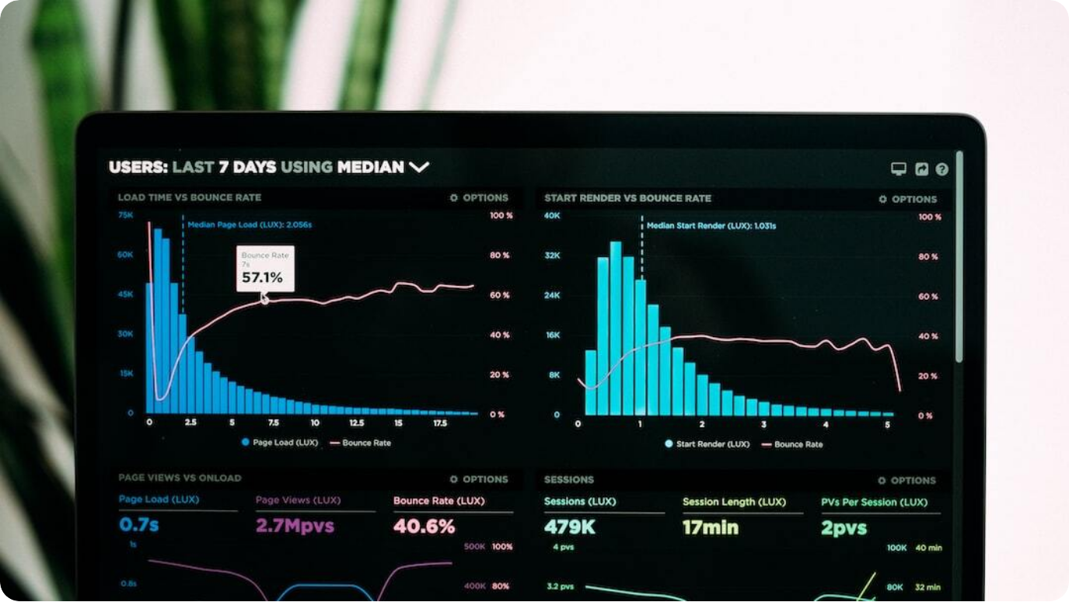
Gap Analysis: Crimsun vs Global Benchmarks
Evaluating Current WLB Standards Against Best Practices
Limited Flexibility: Crimsun lacks remote/hybrid models, unlike global firms like Google, SAP
Inconsistent Policy Awareness: Many employees unaware or unsure about HR support systems
Commute & Fatigue: High commute stress not addressed, unlike firms offering transport or housing
Notes:
When compared to global best practices, Crimsun’s work-life balance framework shows specific gaps that warrant attention. Unlike leading organizations that offer remote or hybrid flexibility, Crimsun has no structured provision for such models—74% of employees report this absence.
Another gap is inconsistent awareness and application of HR policies. While some staff feel supported, others are unclear about their rights or available programs. This inconsistency reflects communication and training deficiencies.
Lastly, commute-related fatigue is a major stressor that global firms mitigate through flexible hours, transportation support, or satellite offices—none of which are present at Crimsun. Addressing these gaps is crucial to elevate Crimsun’s standing as a competitive and employee-friendly company.

Slide 12
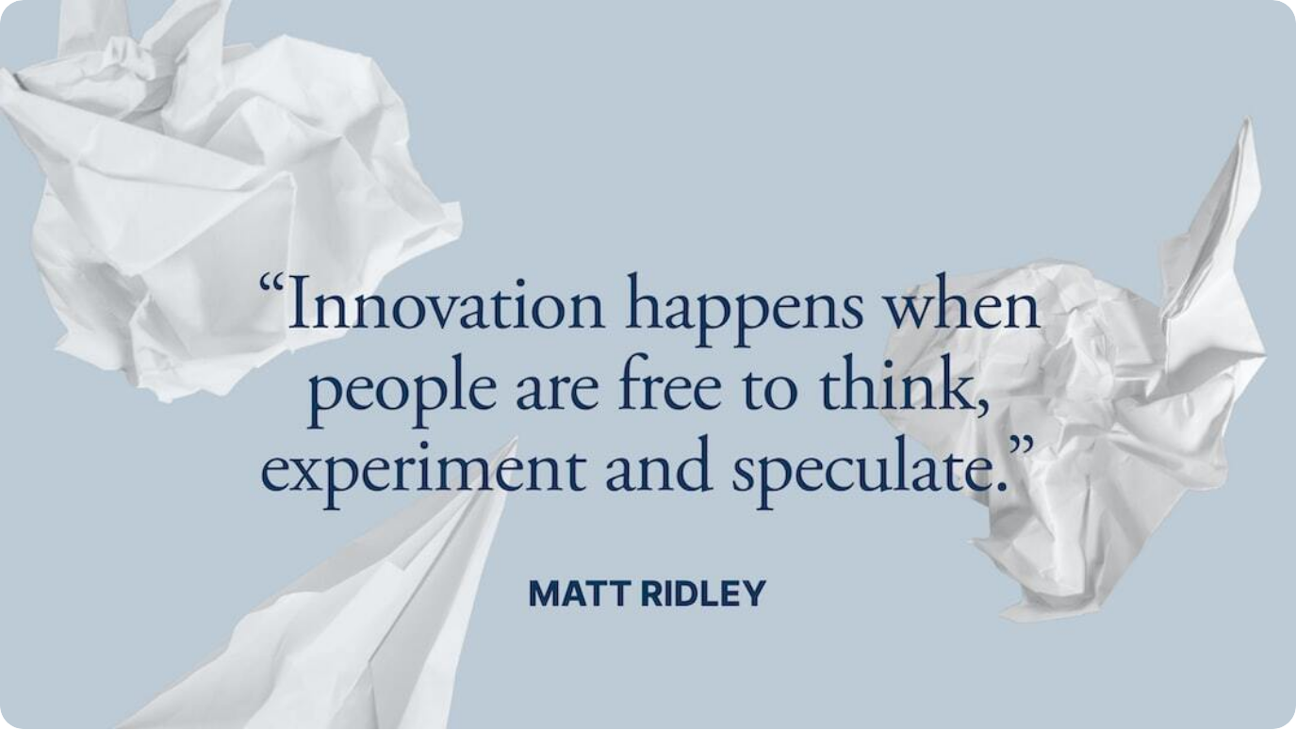
Recommendations for Crimsun
Enhancing Work-Life Balance Strategically
Introduce Hybrid Work Options: Start with pilot programs for administrative roles to test flexibility
Formalize Manager Training: Educate supervisors to consistently support and communicate WLB policies
Commute Support Initiatives: Provide shuttles, staggered hours, or location-specific allowances
Notes:
To address current gaps and align with international standards, Crimsun should begin by exploring hybrid work possibilities—particularly for non-production roles. This offers flexibility and aligns with employee expectations without disrupting operations.
Second, formal training for line managers is crucial. Many inconsistencies in policy awareness and application stem from the managerial level. Creating HR toolkits and conducting monthly check-ins can institutionalize support.
Lastly, addressing commute stress would show direct concern for daily employee pain points. Company-arranged transport, staggered shift timing, or local housing support are proven global strategies that can be adapted to Crimsun’s context.

Slide 13



Implementation Roadmap
Phased Strategy for WLB Enhancement at Crimsun
Phase 1: Policy Design
Form WLB task force; define hybrid eligibility; draft transport policies
Phase 2: Pilot Programs
Test hybrid roles, train managers, monitor shuttle/staggered hour uptake
Phase 3: Full Rollout & Monitoring
Expand successful pilots, conduct annual WLB surveys, track turnover KPIs
Notes:
The transition to a stronger work-life balance culture at Crimsun should be structured through phased implementation. Phase one includes policy formulation—creating a cross-functional task force, identifying pilot departments, and formalizing manager roles in WLB.
In phase two, Crimsun should roll out pilots. This includes hybrid models for admin roles, HR workshops, and staggered shift experiments. Performance and feedback metrics should be recorded to refine the approach.
Finally, a full organizational rollout based on pilot results should be pursued. This includes publishing policy documents, integrating metrics into performance reviews, and conducting regular pulse surveys to track employee engagement and satisfaction.

Slide 14



Crimsun’s Vision for Work-Life Balance
Towards a Resilient, Empowered Workforce
Purpose
To build a high-performance culture grounded in employee well-being
Commitment
Delivering flexible, inclusive, and supportive HR frameworks by 2026
Impact
Enable sustainable growth through retention, engagement, and innovation
Notes:
Crimsun’s vision for work-life balance is not simply about adding new HR features—it’s about reshaping the organizational culture. The long-term goal is to create a performance-driven yet empathetic environment where every employee feels valued.
By 2026, Crimsun aims to implement a flexible and inclusive HR system that aligns with global best practices while respecting its unique operational context. This includes formal policies on flexible work, mental health, and manager empowerment.
Ultimately, a strong work-life balance strategy will ensure that Crimsun doesn’t just retain talent—it will cultivate innovation, resilience, and a strong brand reputation in the competitive agrochemical industry.

Slide 15

Conclusion & Q/A
Summing Up & Interactive Discussion
Key Takeaways: Crimsun has foundational WLB systems but needs strategic modernization
Path Forward: Hybrid work, manager training, and commute support can elevate impact
Open for Questions: Ready to discuss insights, data, and recommendations in detail
Notes:
To conclude, Crimsun Organics has already made noteworthy efforts in supporting work-life balance. Fixed working hours and flexible leave access are strong starting points.
However, this study highlighted areas that require proactive attention—especially around remote work, HR policy awareness, and manager-led culture. Strategic reforms in these domains will not only enhance employee satisfaction but also contribute to organizational stability and innovation.
I’m now open to any questions or feedback you may have regarding the project findings or proposed strategies. Thank you for your attention and engagement.

